Slide 1
Stock Price Prediction Model
Submitted by : Akash Verma
Email: averma9838@gmail.com

Slide 2
Explanation of results and logic behind the code
I have taken data from the Yahoo Finance.
I have used 80% of the total available data from training purpose and the remaining 20% data for the testing purpose.
I have used Keras, LSTM for predicting the results.
I have got a score of 0.93 for testing data.
Logic :-
Firstly I have converted the data from 2-D to 3-D form using
reshape() function. After that I have used ‘adam’ optimizer with
‘Mean Square Error’ to train the model over the training data.
Details about epochs and other parameters can be seen in the code,
I have tuned the parameters to find the best fit for the model.

Slide 3
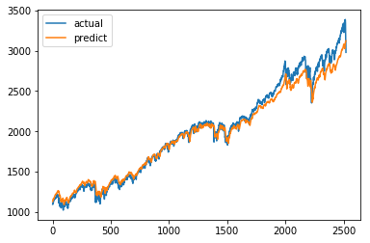
Graph Between Actual and Predicted Result

Slide 4
Actionable Trading Strategies On The Basis Of Results
In the model I have done comparision between the actual and predicted values of the stocks. As the model is getting score of 0.93 with the testing data, so we can use the model to perform prediction for the future days. We can add a mean error to those predictions and on the basis of those predictions, we can build our strategies for buying or selling of the stocks.
If the hike in future prices of the stocks as predicted by our model is more than a threshold value say ‘h’, then we can buy the stocks. Also, if the drop in prices of stocks in upcoming days is more than a threshold value say ‘d’, then we can decide to sell those stocks as soon as possible. We can find these values ‘h’ and ‘d’ from the analysis of previous data.

Slide 5
Creative Ideas For Future Data And Model Building
We can add some form of unsupervised learning to our model to find some kind of pattern between the days on which the difference between the price of stocks as predicted by our model and actual price is more than a particular threshold value. This will help us to identify those days in future on which our model may give bad predictions.
We can use web scraping to find the latest news and trends regarding the stocks, after that we can analyze that data. This might help our model to provide better predictions.

Slide 6
Resources Or Papers Used For This Submission
Yahoo Finance – Fetched data regarding prices of stocks.
Economictimes – Used this website to understand about the stocks
and general trends in stock marketing.
Link : https://economictimes.indiatimes.com/markets/stocks/news

